Slide 1
UX DESIGN PROCESS
We apply design thinking to product design, we would follow a UX process with the following five key phases:
Product definition
Research
Analysis
Design
Validation

Slide 2
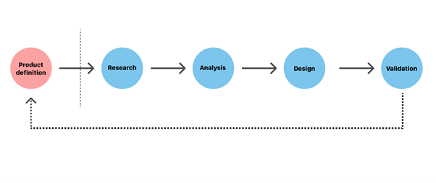

Slide 3
1. Product definition
One of the most important phases in UX design is actually done before the product team creates anything. Before you can build a product, you need to understand its context for existence. The product definition phase sets the foundation for the final product. During this phase, UX designers brainstorm around the product at the highest level (basically, the concept of the product) with stakeholders.
This phase usually includes:
Stakeholder interviews: interviewing key stakeholders to gather insights about business goals.
Value proposition mapping: thinking about the key aspects and value propositions of the product: what it is, who will use it, and why they will use it. Value propositions help the team and stakeholders create consensus around what the product will be and how to match user and business needs.
Concept sketching: creating an early mockup of the future product (can be low-fidelity paper sketches of the product’s architecture).
This phase typically ends up with a project kick-off meeting. The kick-off meeting brings all the key players together to set proper expectations both for the product team and stakeholders. It covers the high-level outline of the product purpose, team structure (who will design and develop the product), communication channels (how they will work together), and what stakeholders’ expectations are (such as KPIs and how to measure the success of the product).

Slide 4
2. Product research
Once you’ve defined your idea, the product team moves to the research phase. This phase typically includes both user research and market research. Seasoned product designers think of research as a good investment—good research informs design decisions and investing in research early in the process can save a lot of time and money down the road.
Individual in-depth interviews (IDI). A great product experience starts with a good understanding of the users. In-depth interviews provide qualitative data about the target audience, such as their needs, wants, fears, motivations, and behavior.
Competitive research. Research helps UX designers understand industry standards and identify opportunities for the product within its particular niche.

Slide 5
3. Analysis
The aim of the analysis phase is to draw insights from data collected during the research phase, moving from “what” users want/think/need to “why” they want/think/need it. During this phase, designers confirm that the team’s most important assumptions are correct.
This phase of the UX process usually includes:
Creating user personas. Personas are fictional characters that represent the different user types for your product. As you design your product, you can reference these personas as realistic representations of your target audience.

Slide 6
4. Design
When users’ wants, needs, and expectations from a product are clear, product designers move to the design phase. At this step, product teams work on various activities, from creating information architecture (IA) to the actual UI design. An effective design phase is both highly collaborative (it requires active participation from all team players involved in product design) and iterative (meaning that it cycles back upon itself to validate ideas).

Slide 7
Validation (Testing)
Validation is an essential step in the design process because it helps teams understand whether their design works for their users. Usually, the validation phase starts after the high-fidelity design is ready, since testing with high-fidelity designs provides more valuable feedback from end-users). During a series of user testing sessions, the team validates the product with both stakeholders and end-users

